Slide 1

Web API
bilan ishlash

Slide 2
API (Application Programming Interface) – bir dastur bilan boshqasi o'rtasidagi aloqani ta'minlovchi vosita.

Slide 3
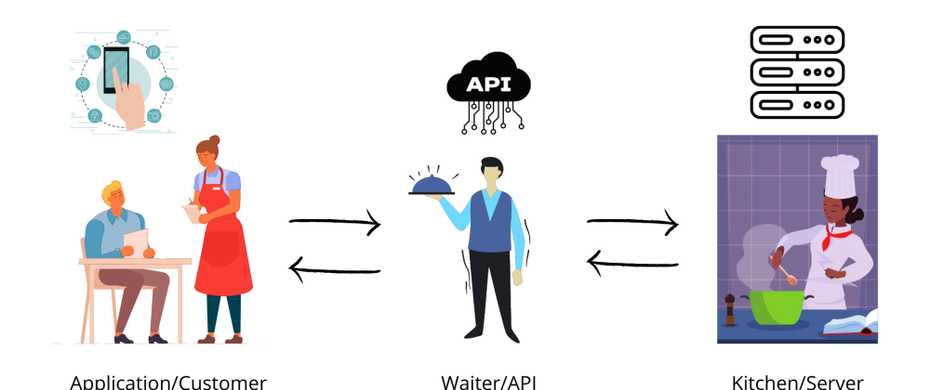

Slide 4
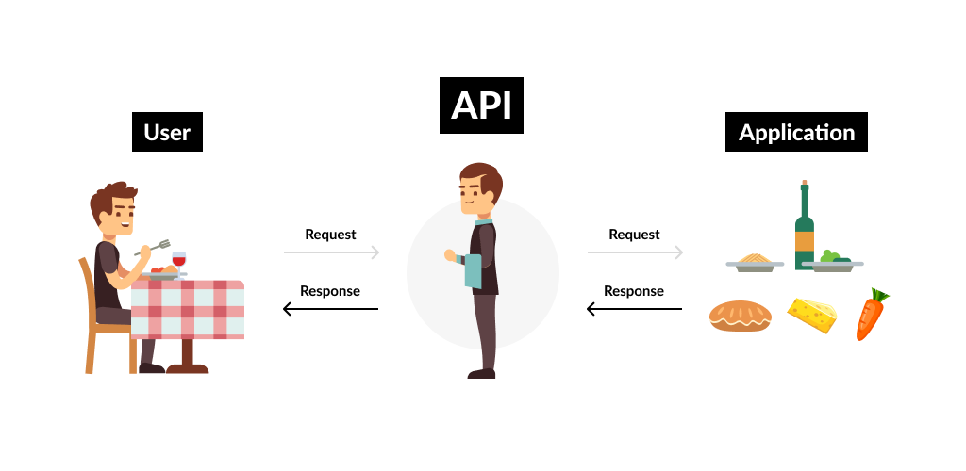

Slide 5
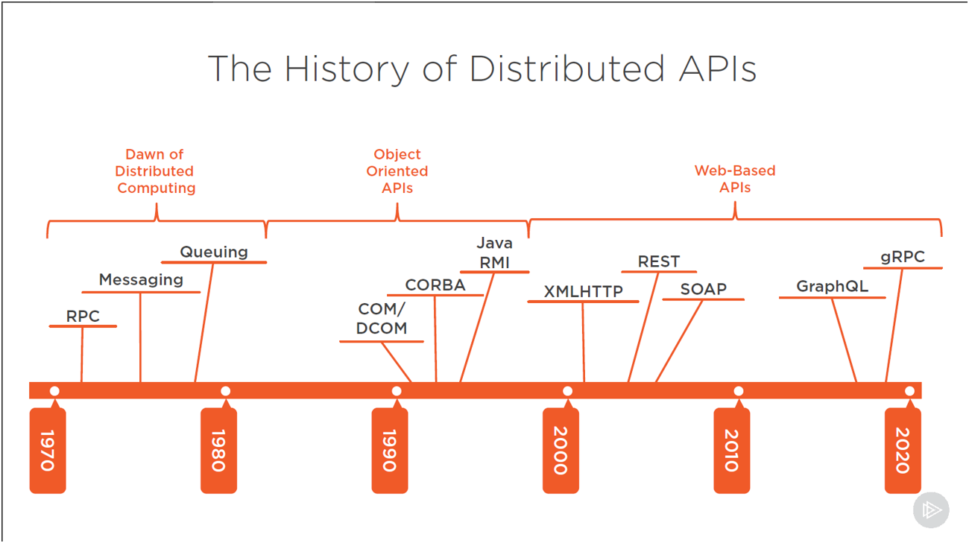

Slide 6




HTTP qanday ishlaydi?
POST
Content Length: 13
Hello World
Request
Response
201
Content Type: text
Hello World

Slide 7
Request tuzulishi
Serverda bajarilishi kerak bo’lgan harakat
Verb(Action)
GET: Resurs olish
POST: Resurs yaratish
PUT: Resursni o’zgartirish
PATCH: Resursni bir qismini o’zgartirish
DELETE: Resursni o’chirish
Boshqalar…
Headers
Content

Slide 8
Request tuzulishi
So’rov to’g’risida qo’shimcha ma’lumot
Verb(Action)
Content Type: Kontent turi
Content Length: Kontent uzunligi
Authorization: Chaqiruvni kim amalga oshiryapti
Cookies: Foydalanuvchi ma’lumoti
Boshqalar…
Headers
Content
Content

Slide 9
Request tuzulishi
So’rov tanasi
Verb(Action)
HTML, CSS, JS, XML, JSON
Kontent ba’zi verblar uchun shart emas
Headers
Content

Slide 10
Response tuzulishi
Statuslar
Status code
100-199: Informations
200-299: Success
300-399: Redirection
400-499: Client Errors
500-599: Server errors
Headers
Content

Slide 11
Response tuzulishi
Javob to’g’risida qo’shimcha ma’lumot
Status code
Content Type: Kontent turi
Content Length: Kontent uzunligi
Expires: Yashash muddati
Cookies: Foydalanuvchi ma’lumoti
Boshqalar…
Headers
Content

Slide 12
Response tuzulishi
Javob tanasi
Status code
HTML, CSS, JS, XML, JSON
Headers
Content

